Slide 1
開發抗菌素電子交易紀錄系統平台簡報會 Briefing Seminar on Development of the Computerised Transaction Record (CTR) System for Antimicrobials
by
衞生署藥物辦公室牌照及監察科
Department of Health
Drug Office, L&C Division
( Mr. John M.T. LAU )
BPharm, Reg. Pharm, MBA (Health Services Management), BPharm(ChinMed)

Slide 2
WDL
XX/2A/YYYY

Slide 3
AP
XX/1A/YYYY

Slide 5
香港藥劑業歷史點滴
1937 藥劑業及毒藥法例正式立法
1945 重組政府"中央藥庫” Central Medical Store (CMS)
1950 藥劑業委員會成立
1992 香港中文大學醫學院增設藥劑學系
1995 Hong Kong GMP Guidelines for Pharmaceutical Products
2005 診所配錯藥(糖尿病藥)及其後有關書面訂單的規定
2009 香港藥物監管制度檢討委員會報告
2009 香港大學藥理及藥劑學系藥劑學士課程
2015 2015年藥劑業及毒藥(修訂) 條例
2015 批發商牌照持有人執業守則(2015)
2016 香港藥劑業及毒藥管理局加入國際醫藥品稽查協約組織(PIC/S)

Slide 6
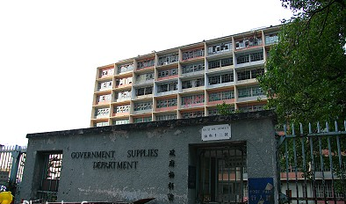
CMS

Slide 8
Company Name | Licence Number
Merck Sharp & Dohme (Asia) Ltd. 美國默沙東藥廠有限公司 | 79/2A/1957
Luen Cheong Hong Ltd. 聯昌行有限公司 | 96/2A/1957
Hong Kong Medical Supplies Ltd 港聯醫藥供應有限公司 | 4/2A/1958
Primal Chemical Co Ltd 定一化學有限公司 | 141/2A/1958
United Italian Corporation (H.K.) Ltd. 永義（香港）有限公司 | 75/2A/1960
Trinity Trading Co Ltd 和信醫藥有限公司 | 13/2A/1964
Controlled Medications Limited 康德行有限公司 | 63/2A/1976
Johnson & Johnson (Hong Kong) Ltd 強生﹙香港﹚有限公司 | 26/2A/1977
Shun On Healthcare Ltd. 信安醫療有限公司 | 62/2A/1977
Well Favoured Ltd 偉輝(香港)有限公司 | 29/2A/1979
Hind Wing Company Limited 顯榮行有限公司 | 33/2A/1979
Yick-Vic Chemicals & Pharmaceuticals (HK) Ltd 伊域化學藥業(香港)有限公司 | 3/2A/1981
Mekim Limited 美儉有限公司 | 37/2A/1983
Treasure Mountain Development Company Limited 煒寶發展有限公司 | 22/2A/1984
Reckitt Benckiser Hong Kong Limited 利潔時有限公司 | 71/2A/1985

Slide 14
簡報摘要 Briefing Contents
有關抗菌素耐藥性 About Antimicrobial Resistance
香港抗菌素耐藥性策略及行動計劃 Hong Kong Strategy and Action Plan on Antimicrobial Resistance
持牌藥商須保存的記錄 Records kept by Licensed Traders
開發抗菌素電子交易紀錄系統平台 Development of Computerised Transaction Record (CTR) System
抗菌素電子交易紀錄系統平台[LSCM] Computerised Transaction Record (CTR) System for Antimicrobials [LSCM]
與業界的溝通 Communications with Traders

Slide 15
有關抗菌素耐藥性About Antimicrobial Resistance
抗菌素耐藥性威脅全世界 Antimicrobial Resistance (AMR) poses a Global Health Threat
抗菌素耐藥性是指細菌演變成能抵抗原本有效的藥物。感染耐藥性細菌的病人的患病時間會因而延長，甚至會增加死亡風險，而濫用和過度使用抗生素是導致產生耐藥性細菌的主要因素。 Antimicrobial Resistance (AMR) arises when microorganisms evolve and become resistant to previously effective antimicrobials. When patients are infected with drug-resistant microorganism, their illness may be prolonged, and may even increase the risk of death. The misuse and overuse of antibiotics (antimicrobials) are the major factors leading to the development of drug-resistant microorganisms.
根據世界衞生組織（世衞）的資料，抗菌素耐藥性已被列為 人類面臨的十大全球公共衞生威脅之一。 The World Health Organization (WHO) declared AMR as one of the top ten global public health threats facing humanity

Slide 16
世衞提倡採納「一體化健康」的方針 WHO advocates the adoption of a "One Health" approach
世衞提倡採納「一體化健康」的方針，這需要各公共衞生、動物和生態健康領域的持份者群策群力（包括藥劑業界及持份者），緊密合作，以推動全球行動來應對抗菌素耐藥問題。 WHO advocates for the adoption of a "One Health" approach with intersectoral collaboration between public health, animal and environment health sectors (including the pharmaceutical traders and stakeholders) to promote global action to address AMR.
一般而言，「抗微生物藥物」（或抗菌素）包括抗細菌藥物、抗病毒藥物、抗真菌藥物和抗寄生蟲藥物，主要用於預防和治療人類、動物和植物感染。 Generally speaking, "antimicrobial drugs" (or antimicrobials) include antibacterial drugs, antiviral drugs, antifungal drugs and antiparasitic drugs, mainly used for the prevention and treatment of human, animal and plant infections.

Slide 17
抗菌素耐藥性高層督導委員會 High Level Steering Committee on Antimicrobial Resistance
政府一直高度重視應對抗菌素耐藥性的必要性，並於2016年成立抗菌素耐藥性高層督導委員會（督導委員會），旨在鼓勵各專業界別在「一體化健康」框架下攜手協作及互相交流。 The Government has been placing great importance on addressing the necessity of combating the threat of AMR. In 2016, the High Level Steering Committee on Antimicrobial Resistance (HLSC) was established. The aim was to encourage professional sectors to collaborate and exchange ideas within the framework of "One Health".
政府於 2022 年發表第二份《香港應對抗菌素耐藥性策略及行動計劃》（《行動計劃》），為 2023 年至 2027 年制訂應對抗菌素耐藥性威脅而採取的策略。 In 2022, the Government launched the Hong Kong Strategy and Action Plan on Antimicrobial Resistance (2023-2027) (Action Plan), this action plan map out response strategies towards the threat of AMR.

Slide 18
定為優先措施的目標 Objective with Priority Intervention
《行動計劃》其中一個建議是加強監管在沒有處方下售賣抗菌素的行為，包括檢討及考慮修訂有關條例，規定以電子方式系統地記錄抗菌素處方及配藥資料，並確保在供應鏈（從批發到交付至最終使用者）內妥善保存抗菌素記錄，從而打擊無處方下售賣抗菌素的問題。 One of the Action Plan’s recommendations was to strengthen regulation on over-the-counter purchase of prescription-only antimicrobials, which includes amending relevant Ordinance(s) to mandate recording of antimicrobial prescription and dispensing data systematically through electronic means and ensure proper record keeping of antimicrobials along the supply chain, from wholesale to supply to end users, so as to combat the sales of antimicrobials without prescription

Slide 19
持牌藥商須保存的記錄 Records be kept by Licensed Traders
抗生素條例《第137章》 Antibiotics Ordinance Cap. 137
藥劑業及毒藥條例《第138章》 Pharmacy and Poisons Ordinance Cap. 138

Slide 20
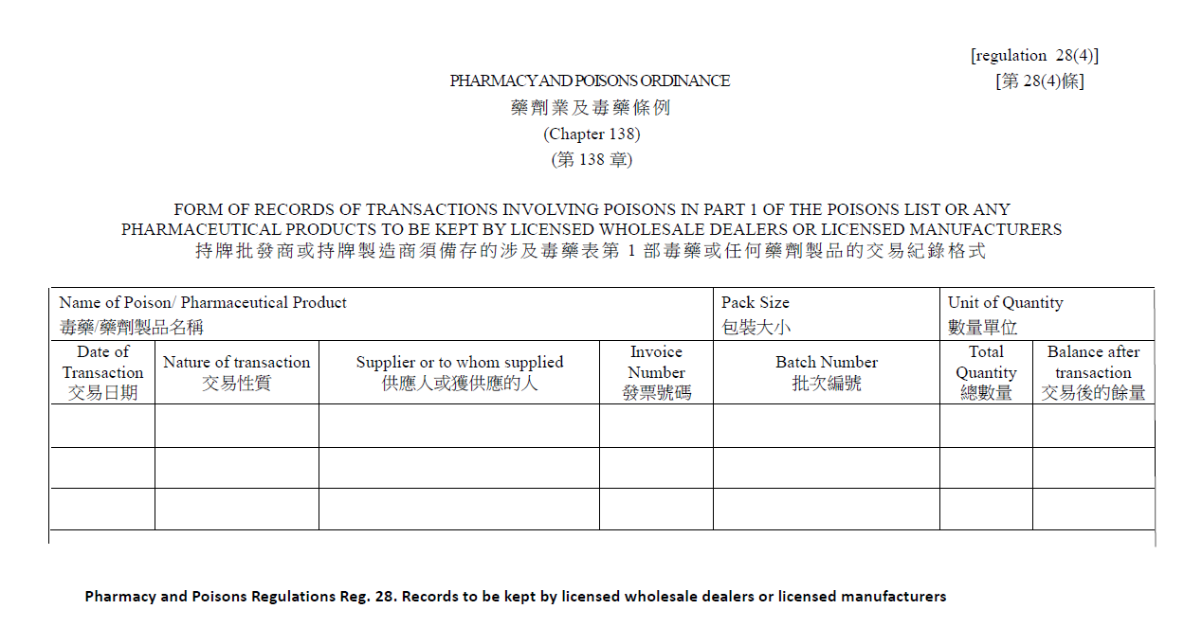
獲授權製造商和批發商的記錄 Record by Licensed Manufacturer & Wholesaler

Slide 21
獲授權毒藥銷售商的抗生素記錄 Antibiotics Record by Authorised Sellers of Poison
獲授權毒藥銷售商常用格式 Format commonly used by ASP

Slide 22
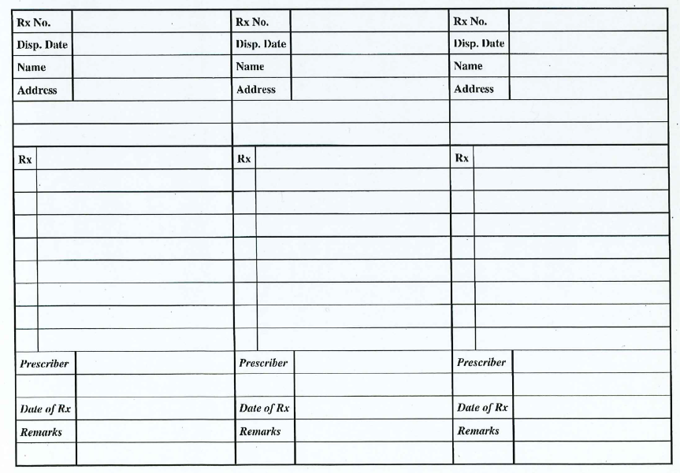
獲授權毒藥銷售商的處方記錄 Prescription Record by Authorised Sellers of Poison
獲授權毒藥銷售商常用格式 Format commonly used by ASP

Slide 23
開發抗菌素電子交易紀錄系統平台 Development of Computerised Transaction Record (CTR) System
為了實踐督導委員會的建議，衞生署與物流及供應鏈多元技術研發中心(LSCM)合作，共同開發抗菌素電子交易紀錄系統平台。 To implement the HLSC’s recommendations, the Department of Health in collaboration with Logistics and Supply Chain MultiTech R&D Centre (LSCM), jointly develop the Computerised Transaction Record (CTR) for Antimicrobials.
這個平台旨在為持牌藥商提供一個便利的紀錄系統，以記錄和查看抗菌素產品交易紀錄，希望這個平台能夠為業界及相關人士帶來方便，並共同推動抗菌素的合理使用和有效監控。 This platform aims to provide licensed traders with a convenient record-keeping system to record and view antimicrobials transaction records. It is hoped that this platform will bring convenience to the industry and relevant personnel, and jointly promote the rational use and effectiveness monitoring of antimicrobials.

